Slide 1
CSCI 335 Database Systems
Zubair Malik

Slide 2
Database Management System (DBMS) provides….
… efficient, reliable, convenient, and safe
multi-user storage of and access to massive
amounts of persistent data.

Slide 3
Massive
Persistent
Safe
Multi-user
Convenient
Efficient
Reliable

Slide 4
Database applications may be programmed via “frameworks”
DBMS may run in conjunction with “middleware”
Data-intensive applications may not use DBMS at all

Slide 5
Key concepts
Data model
Schema versus data
Data definition language (DDL)
Data manipulation or query language (DML)

Slide 6
Key people
DBMS implementer
Database designer
Database application developer
Database administrator

Slide 7
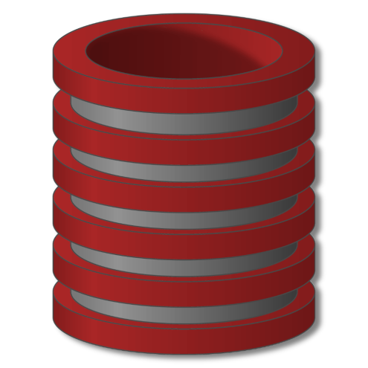
Whether you know it or not,
you’re using a database every day

Slide 8
Essential Queries
Why take this class?
What is this class all about?
Who is running this?
How will this class work?

Slide 9
WHY?

Slide 10
Why? Reason #1: Utility
This class is very, very useful
Data processing backs essentially every app
Databases of one form or another back most apps
The principles taught in this class back nearly everything in computing

Slide 11
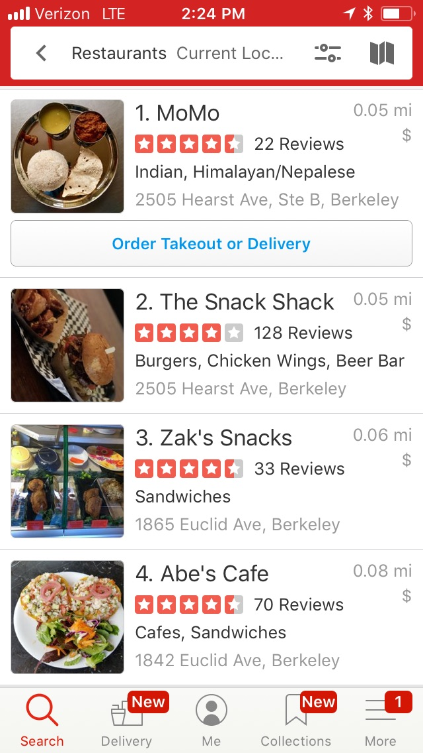
Where shall I eat, Database?
Each ratings star added on a Yelp restaurant review translated to anywhere from a 5% to a 9% effect on revenues.
—Harvard Business School, 2011
http://hbswk.hbs.edu/item/the-yelp-factor-are-consumer-reviews-good-for-business

Slide 12
What am I missing, Database?
https://blog.bufferapp.com/instagram-analytics
https://instagram-press.com/blog/2018/07/02/introducing-youre-all-caught-up-in-feed/

Slide 13
What am I missing, Database? Pt 2
Hey Instagram: that’s Chez Panisse in Berkeley, CA!

Slide 14
Who should I be with, Database?
https://www.gotinder.com/press
https://www.awesomeinventions.com/funny-tinder-profiles/

Slide 15
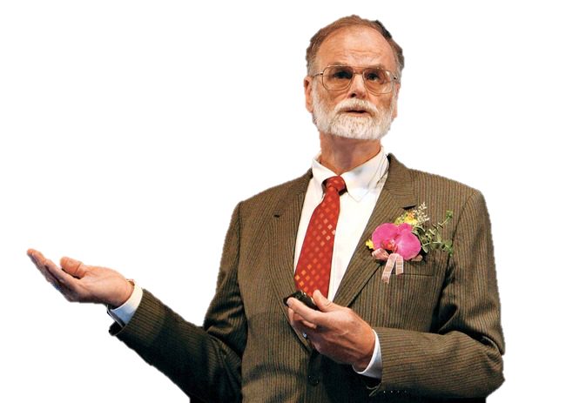
How does Science work? Database.
Jim Gray
Turing Award Winner
First Berkeley CS PhD

Slide 16
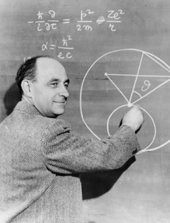
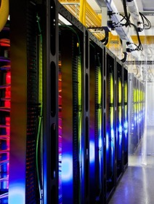
How does Science work? Database. Pt 2
Experimental
Theoretical
Simulation
Data
Intensive

Slide 17
Astronomy in the 4th Paradigm
+
Sloan Digital
Sky Survey (SDSS)
Sky Server
Database
Systems

Slide 18
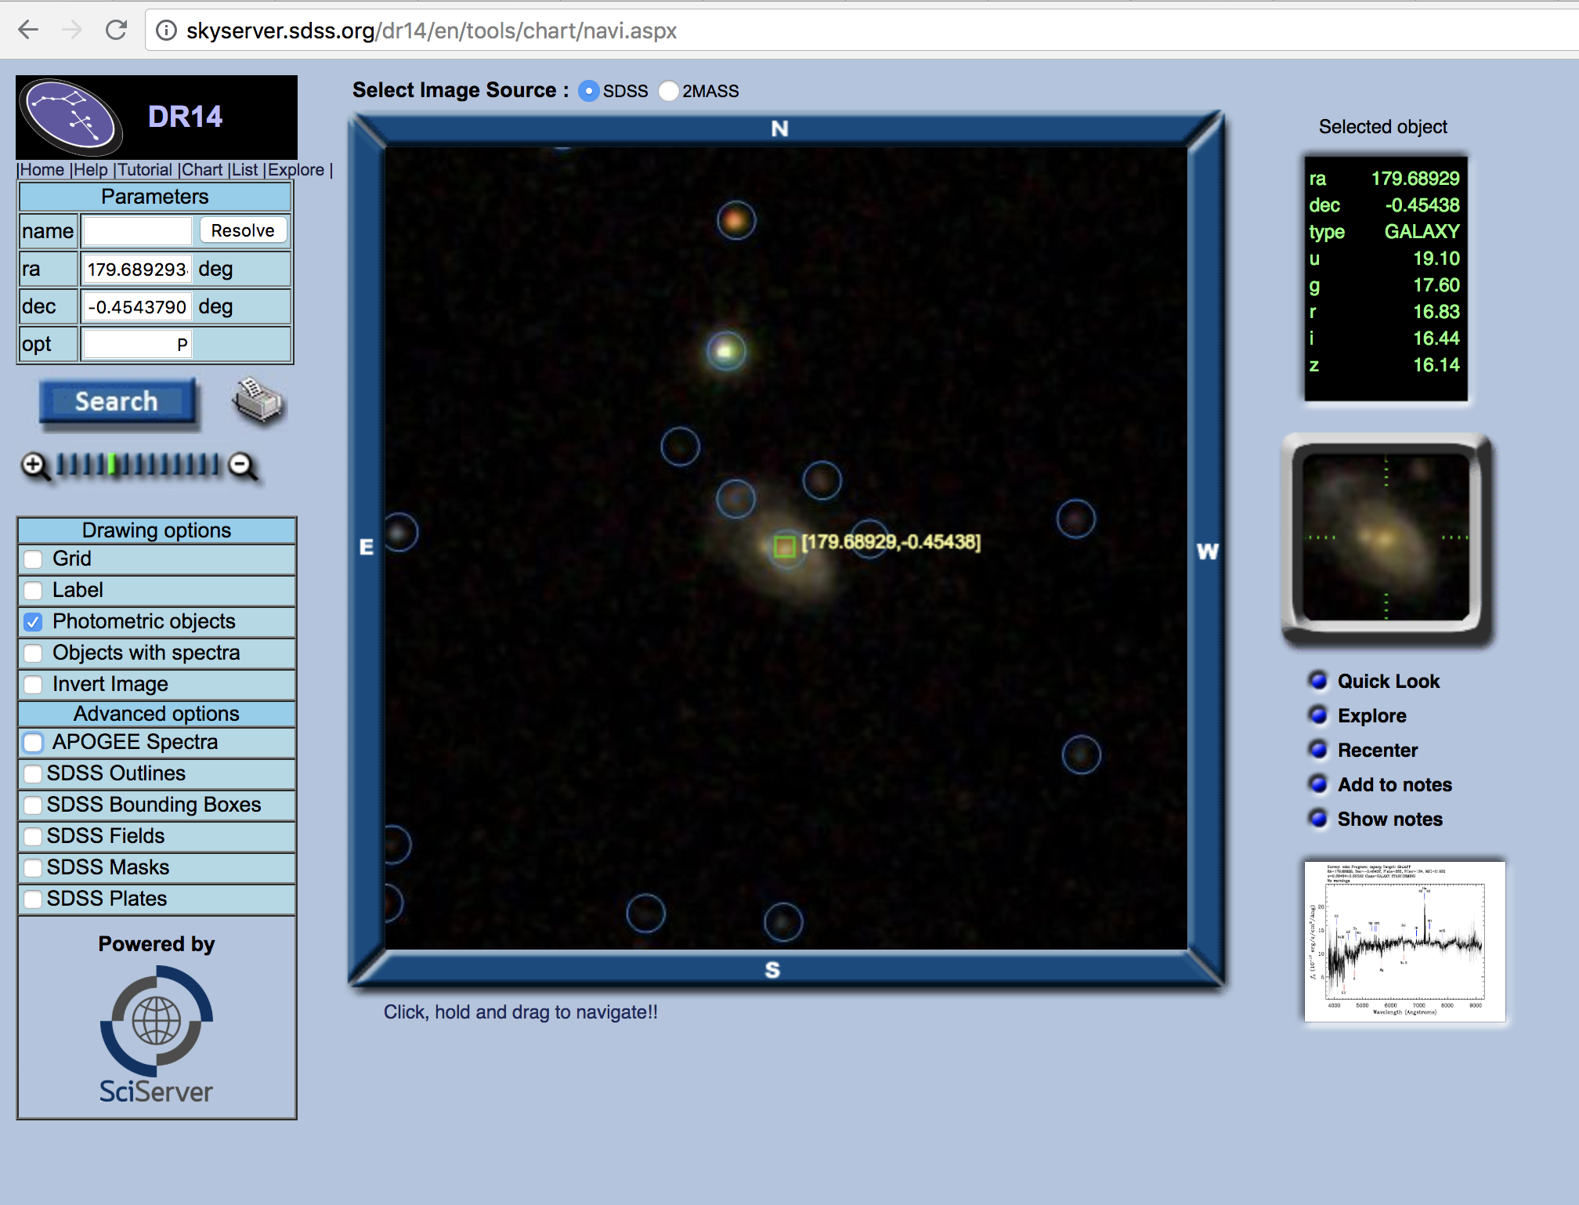
SkyServer
http://skyserver.sdss.org

Slide 19
Science in the 4th Paradigm
http://www.sciserver.org/
Cosmological
Physics
Astronomy
Connectomics
Genomics
Oceanography

Slide 20
Your career…
2000’s:
Shift from “programs” to apps over data-centric services
More recently:
End of the full-stack programmer
New, ubiquitous professions:
Data Scientist
Data Engineer
Machine Learning Engineer
Evolution of IT
Two things to acknowledge:
The fundamentals of this class will stay central
Other things will change
Be prepared to generalize from what you learn here
Keep learning new things

Slide 21
Why? Reason #1: Utility (again)
This class is very, very useful
Data processing backs essentially every app
Databases of one form or another back most apps
The principles taught in this class back nearly everything in computing
This material will empower you.

Slide 22
Why? Reason #2: Centrality
Data is at the center of modern society.
Unprecedented in its nature and significance
Particular and voluminous
Often asymmetric
low value in isolation, high value when aggregated
Difficult to protect

Slide 23
At the center of major issues
Privacy
National Security
Fake News

Slide 24
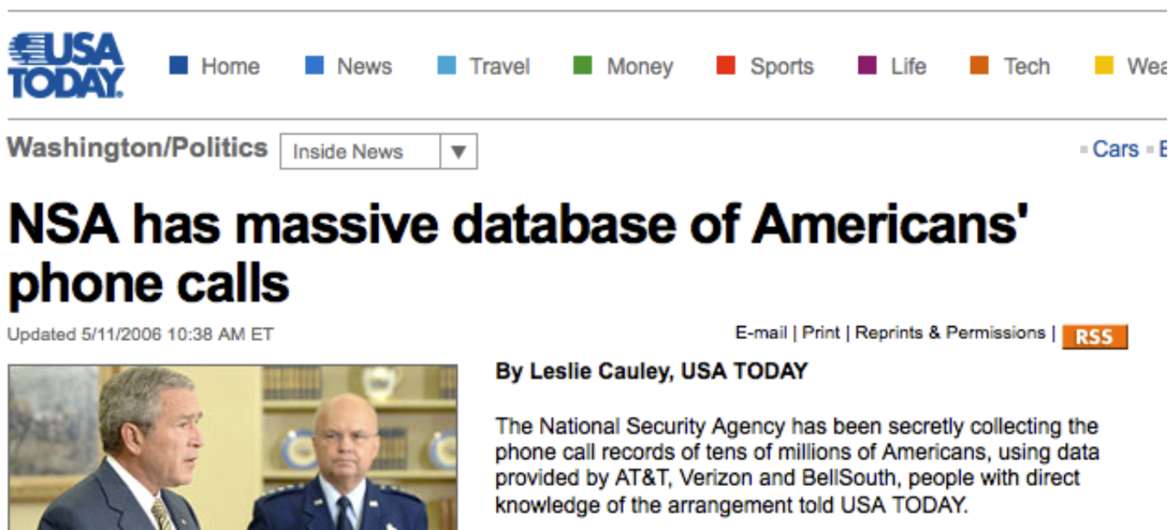
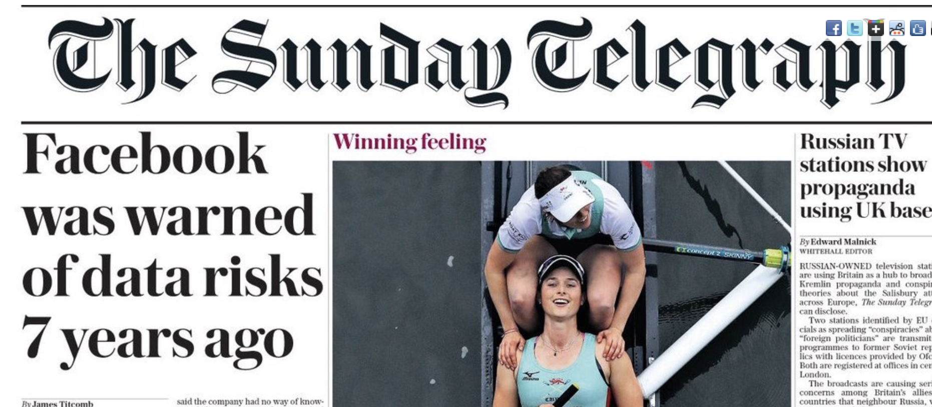
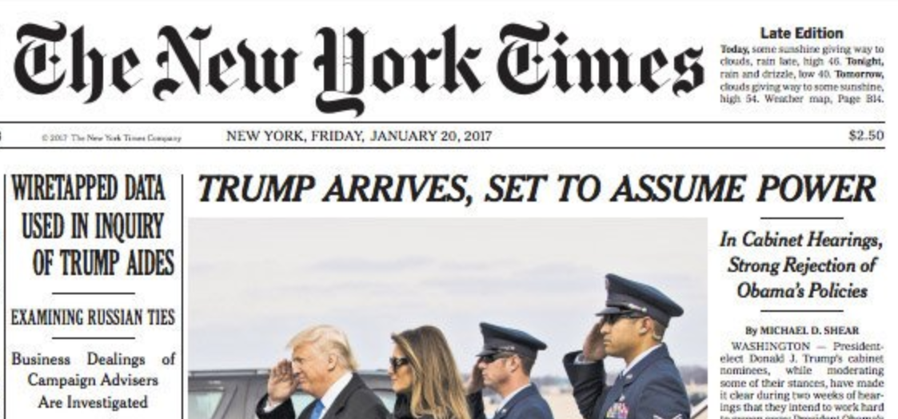
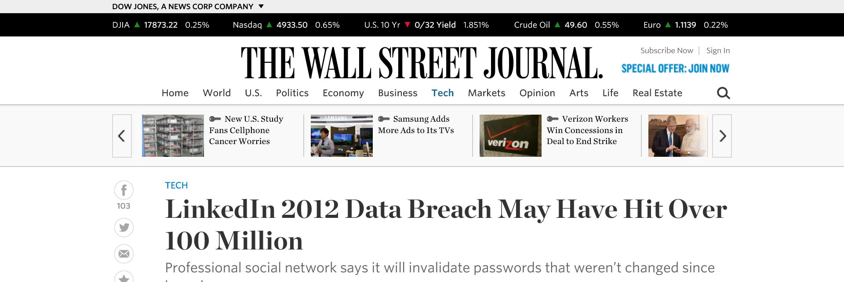
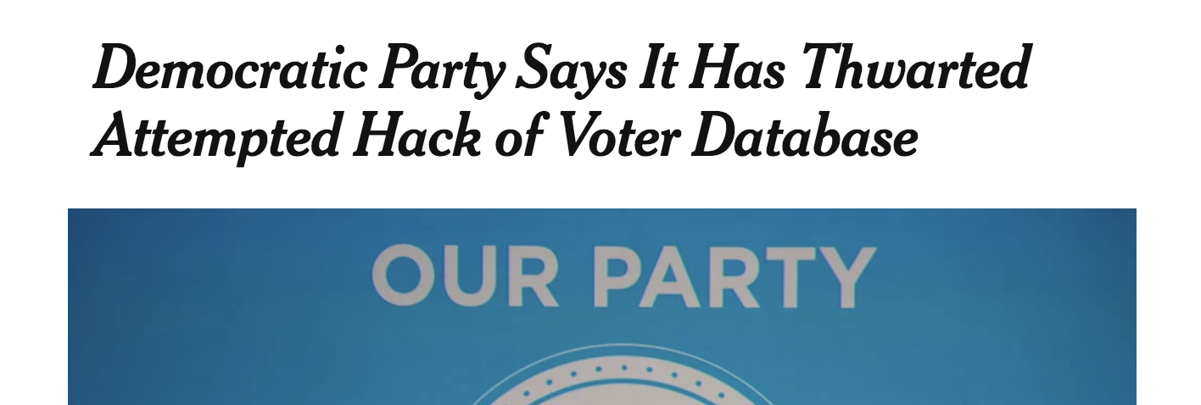
Data Breaches

Slide 25
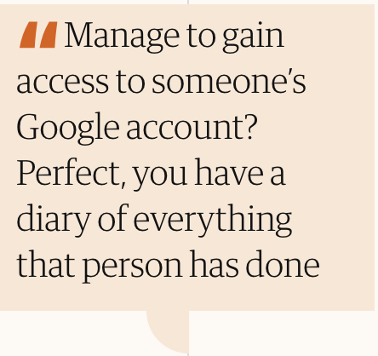
Google Knows

Slide 26
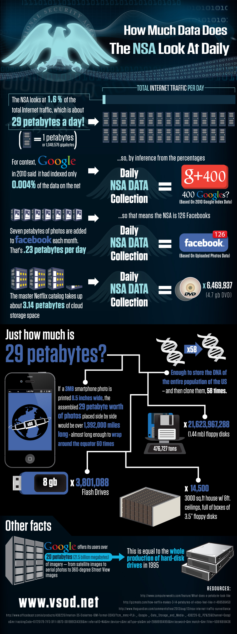
National Security Data: 2010
Notes:
Numbers from the guardian
Xkeyscore is latest system (built on federated MySQL servers) replaced Marianas

Slide 27
National Security Data: 2018

Slide 28
National Security Data: Yesterday

Slide 29
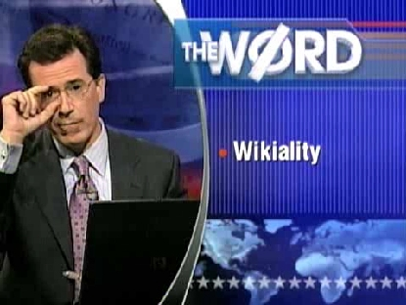
Data Integrity: Not all Data is Correct
“Any user can change any entry, and if enough users agree with them, it becomes true.” – Colbert Report 7/31/2007
Asked users to update the page on Elephants to reflect a tripling population, forcing Wikipedia to lock the page.
Yet a 2005 Nature study found Wikipedia science articles to be similar in accuracy to Encyclopedia Britannica.
COMEDY CENTRAL VIDEO ARCHIVE VIA WIKIPEDIA
http://www.cc.com/video-clips/z1aahs/the-colbert-report-the-word---wikiality
https://en.wikipedia.org/wiki/Reliability_of_Wikipedia
http://www.nature.com/nature/journal/v438/n7070/full/438900a.html

Slide 30
And then came Fake News
01/03/2018

Slide 31
A Syllogism of Quotes
“information is knowledge”
— Albert Einstein
“knowledge is power”
— Sir Francis Bacon
“with great power comes great responsibility”
— Uncle Ben (Spiderman)

Slide 32
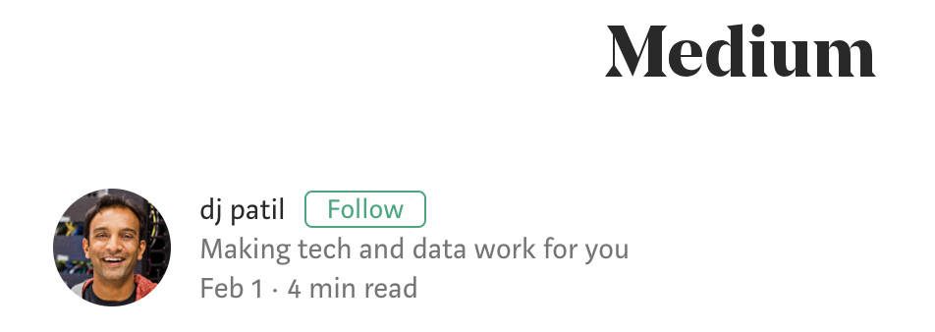
Ethics
“I could go on and on about all of the amazing work that is happening around the world using data to make lives better everyday, but we also have to address where data is causing more harm than good.”
“Data is such an incredible lever arm for change, we need to make sure that the change that is coming, is the one we all want to see.
So how do we do it? First, there is no single voice that determines these choices. This MUST be community effort.”
https://medium.com/@dpatil/a-code-of-ethics-for-data-science-cda27d1fac1
https://www.oreilly.com/ideas/doing-good-data-science

Slide 33
Why? Reason #2: Centrality (again)
Data is at the center of modern society.
Unprecedented in its nature and significance
Particular and voluminous
Often asymmetric
low value in isolation, high value when aggregated
Difficult to protect
The infrastructure determines what’s possible

Slide 34
Why #3? The Core of Computing
Data growth will continue to outpace computation
Systems for Data at Scale: the core of modern computing

Slide 35
Data Will Continue to Grow
And outpace computing power

Slide 36
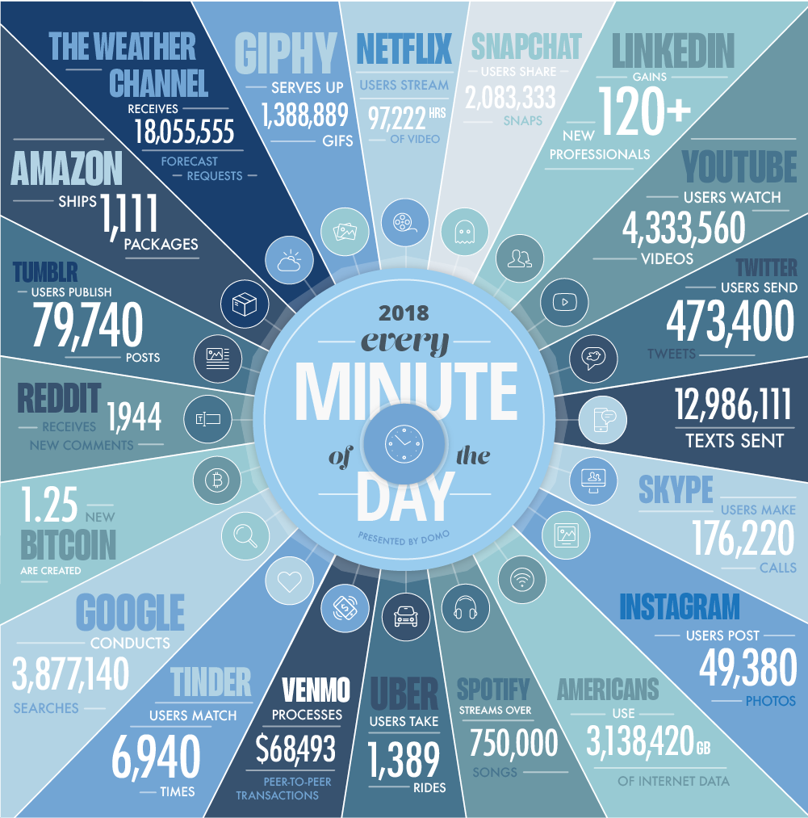
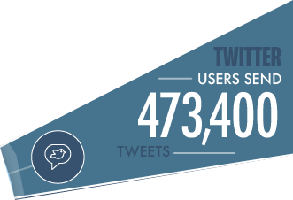
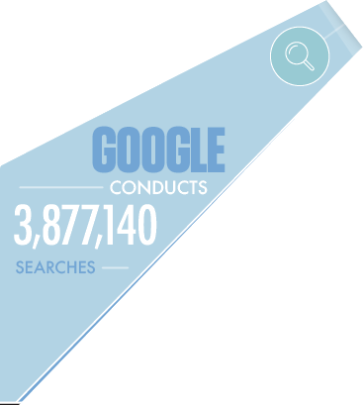
Every Minute!
https://www.domo.com/learn/data-never-sleeps-5

Slide 37
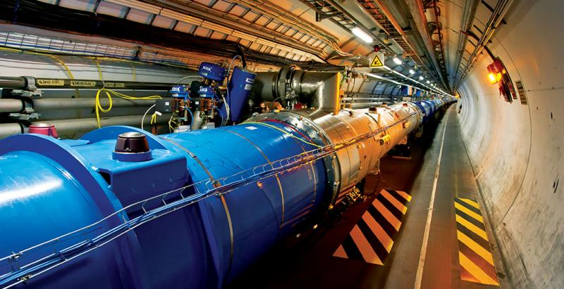
Scale of Scientific Data
Large Hadron Collider, CERN
Raw data: 1MB/event. 600,000,000 events/sec. = 1.9×10²² bytes/year = 19 ZettaBytes/year
Downsampled: 25GB/sec = 7.88×10¹⁷ bytes/year = 788 PetaBytes/year
Downsampled further: 1050MB/sec = 3.3*10¹⁶/year = 33 PetaBytes/year
https://home.cern/about/computing/processing-what-record

Slide 38
Forces Driving Data Growth
Ubiquitous sensors and reporting:
Cameras, mobile computing, blogging, ...
Large collaborative science projects
Philosophy: More Data → More Value?
Enabling Technology
Cheap, Scalable Data Management Systems
http://hyperboleandahalf.blogspot.com
Notes:
http://hyperboleandahalf.blogspot.com

Slide 39
Why #3? The Core of Computing (again)
Data growth will continue to outpace computation
Systems for Data at Scale: the core of modern computing
Techniques you learn in this class underlie many topics in computing

Slide 40
Essential Queries, Pt 2
Why take this class?
What is this class all about?
Who is running this?
How will this class work?

Slide 41
What is this class all about?
Databases?
What is a database?
Database Management Systems?
Implementation?

Slide 42
Universal Symbol for a Database

Slide 43
Why the Symbol?
Platters on a Disk Drive
Looks Like?

Slide 44
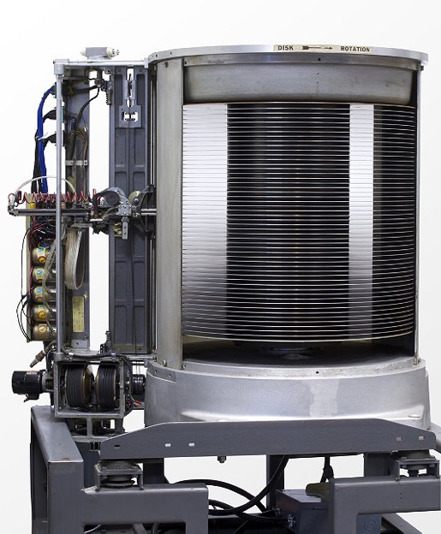
Why the Symbol?, cont
1956: IBM MODEL 350 RAMAC
First Commercial Disk Drive
5MB @ 1 ton
Looks Like?
“...We must immediately...attack accounting problems under the philosophy of handling each business transaction as it occurs, rather than under the present condition of batching techniques....”
-- F. J. Wesley IBM Senior Manager
http://www.computerhistory.org/storageengine/first-commercial-hard-disk-drive-shipped

Slide 45
Is This a Database?
Rolodex
Alphbetically ordered cards
Indexed access by first letter

Slide 46
Is This a Database?, cont
A database + “business logic” + user interface?

Slide 47
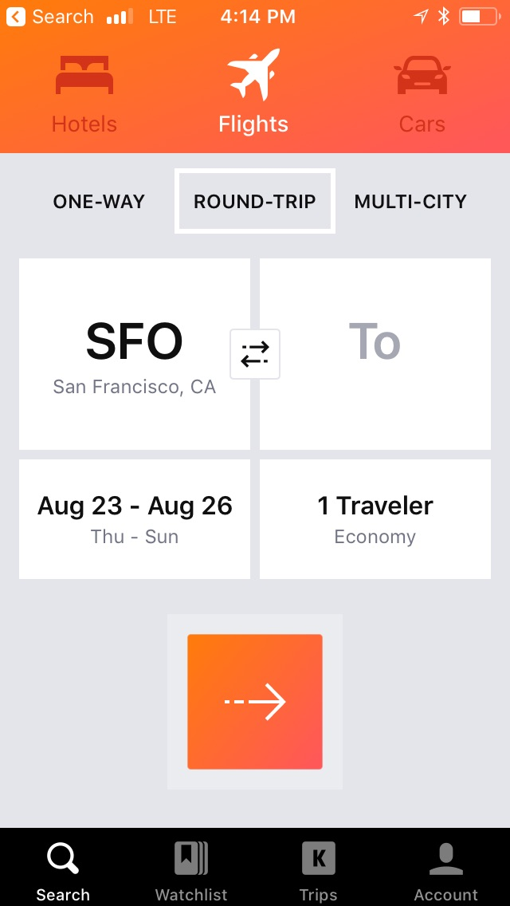
Is This a Database? Part 3
Airline reservation systems were one of the earliest pervasive consumer uses of database systems.
IBM/American Airlines’ SABRE system, 1964.
“Semi-Automated Business Research Environment”
Travelocity.com a direct descendant of SABRE
Acquired by Expedia, 1/2015

Slide 48
What is a Database?
Let’s not split hairs.
A database is a large, organized collection of data.
Sometimes confused with a Database Management System (DBMS)
A DBMS is software that stores, manages, and facilitates access to data.

Slide 49
Relational DBMSs
Traditionally DBMS referred to relational databases
RDBMS is a more appropriate term
SQL data description and manipulation language
ACID transaction consistency
Durable writes (prevent data loss)
Mature technologies …

Slide 50
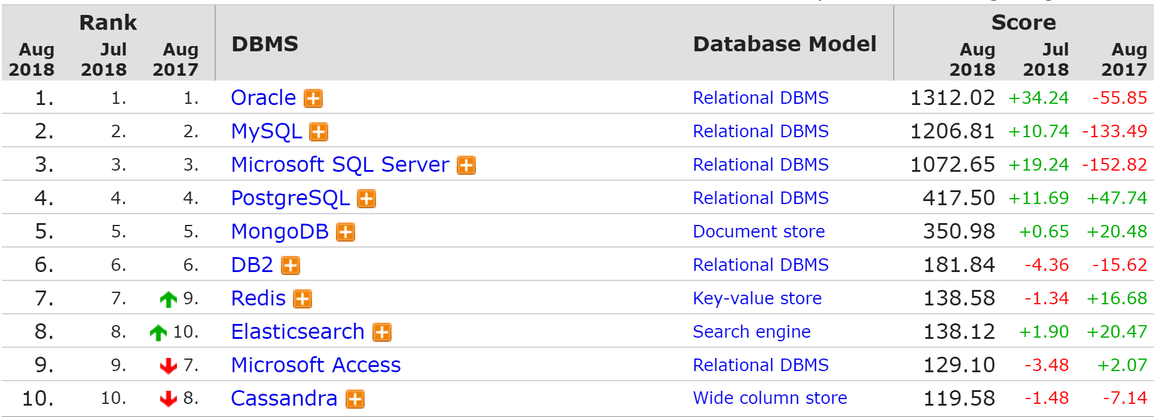
Ranking of DBMS Technologies 2018
Based on #mentions (e.g., stack overflow), google trends, job postings, profile data on LinkedIn, tweets …
http://db-engines.com/en/ranking

Slide 51
Relational Database Market
Big Market > 41B
http://www.infoworld.com/article/2916057/open-source-software/open-source-threatens-to-eat-the-database-market.html
Notes:
http://www.infoworld.com/article/2916057/open-source-software/open-source-threatens-to-eat-the-database-market.html

Slide 52
Relational Database Market, cont
What is happening here?
Hadoop & NoSQL
Notes:
http://www.infoworld.com/article/2916057/open-source-software/open-source-threatens-to-eat-the-database-market.html

Slide 53
Market Trends
Cloud DBMS disrupting on-premises vendors
Cloud is less relational-centric
But fastest-growing services at AWS are RDBMSs
“One size doesn’t fit all”
Main-memory DBMS
Graph DBMS
TimeSeries DBMS
Key-Value Stores (NoSQL)
Analytics Platforms (Spark, Hadoop)
Tools for working with data
Business Intelligence (charting tools)
Data Science platforms
Data preparation and next-generation data integration (ETL)

Slide 54
Reasons for Change
Hardware trends: RAM, SSDs, NVRAM, GPUs, …
Platform trends: cloud and elastic computing
Need to scale: storage and transactions
New data-types: text, json, image, video…
New workloads: machine learning & advanced analytics

Slide 55
Change = Opportunity!
The DBMS world is rapidly changing
Our textbook is rather out of date (2003!)
Opportunity!
You can shape the future of DBMSs
We will not learn the textbook.

Slide 56
Instead…
Focus: Foundational System Principles
Reusable ideas and components
Compositional approach
Goal:
You will be able to use existing & build new DBMS technologies!

Slide 57
You will learn...
Data Oriented Programming with SQL
Foundations of Data System Design
Storage, indexing
Query processing and optimization
Transactions
Concurrency, Consistency, Recovery
Data Modeling
Application-level representations of data

Slide 58
Principles
Data Independence
Declarative Programming
Rendezvous in Time and Space
Isolation and consistency
Data representations

Slide 59
Systems
We will examine various levels of a DBMS
Query Parsing & Optimization
Relational Operators
Files and Index Management
Database Management
System
Concurrency Control
Buffer Management
Recovery
Disk Space Management
Database

Slide 60
What is this class all about?, cont
Databases?
What is a database?
Database Management Systems?
Implementation?
Big Ideas in Database Management Systems
Principles and Algorithms
System Designs
The heart of scalable CS

Slide 61
Essential Queries, Pt 3
Why take this class?
What is this class all about?
Who is running this?
How will this class work?

Slide 62
You!
This class is in your hands.
Everything is doable, with steady work.
We will help pace you

Slide 63
Essential Queries, Part 4
Why take this class?
What is this class all about?
Who is running this?
How will this class work?

